Slide 1
WIA Youth Program
Escambia County
School District

Slide 2
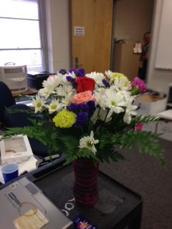
Success Stories
Ayanna Jenkins
Work Experience at
Marathon Health
College Bound this Fall!

Slide 3
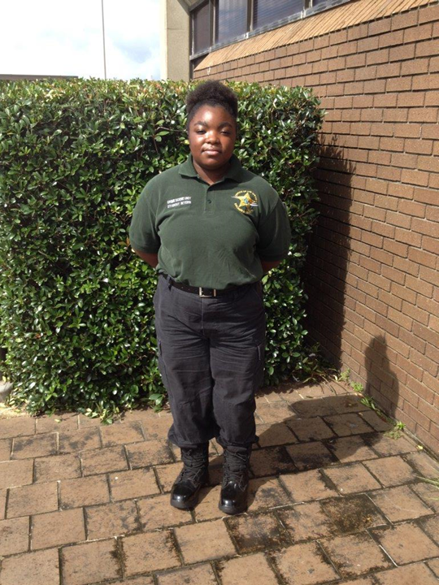
Success Stories
Career Academy Student Intern of the Year!
Aliya
Eggleton

Slide 4
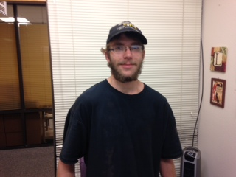
Success Stories
Frank Indelicato
Enrolled in Automotive
Service Technology
Rec’d 3 OCP’s
Co-oping at Meineke
Excellent Life Mgmt Skills

Slide 5
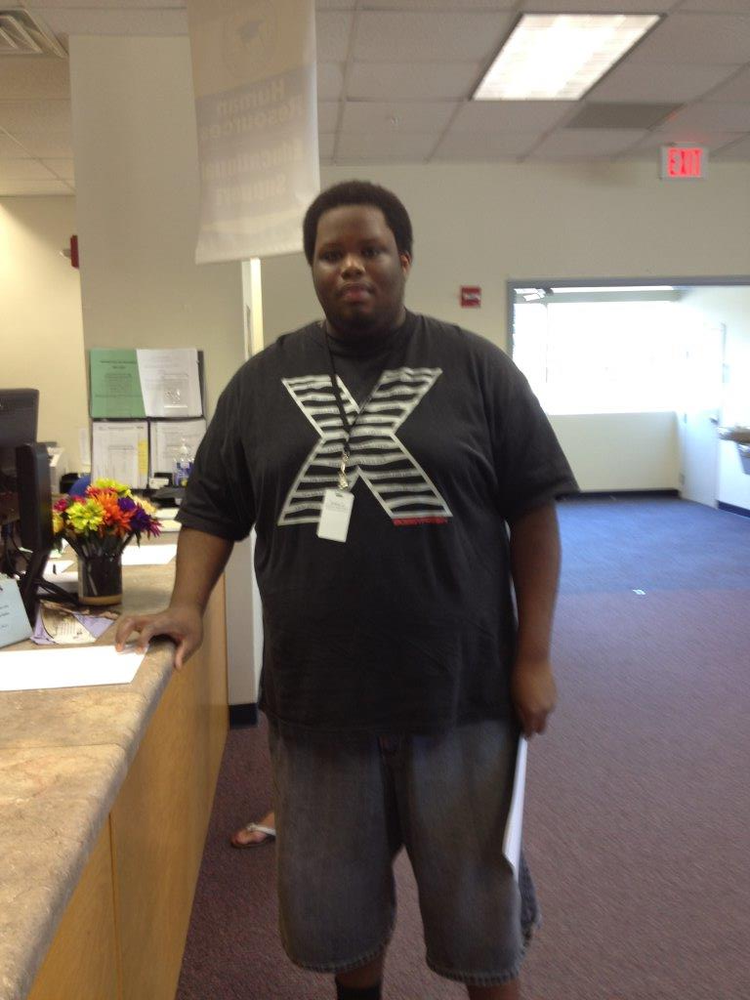
Success Stories
James Holland
Gained valuable work experience
at the ECSD Bus Garage
ECSD New Permanent Employee!

Slide 6
Outstanding Worksites
Warren Averett, LLC
Escambia County Sheriff’s Dept.
(Forensics, Investigations & Records)
Gulf Power Academy
Michael Guttman Law Office
Pathways for Change
N.A.S. Flight Academy

Slide 7

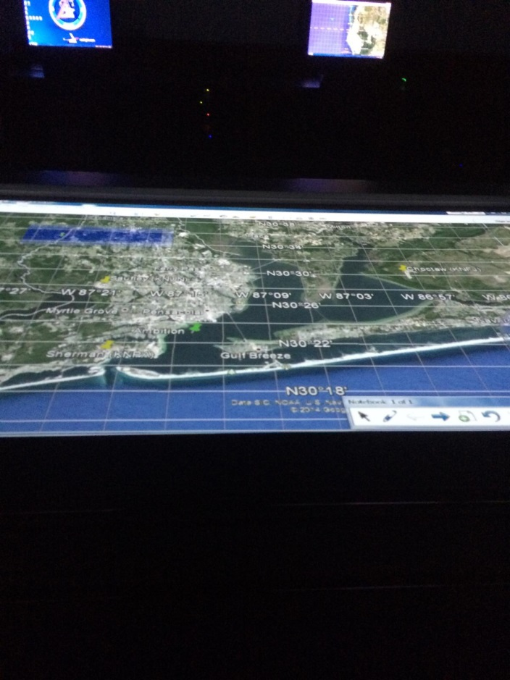
N.A.S. Flight Academy
Pictures from the Carrier Simulator

Slide 8
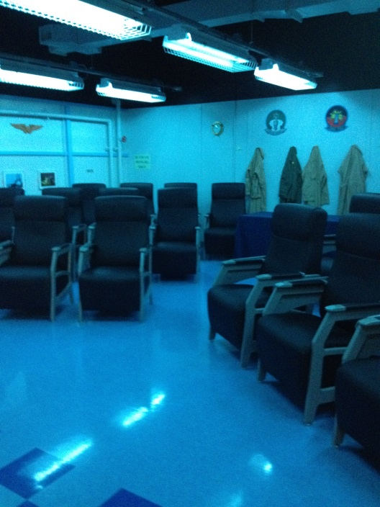
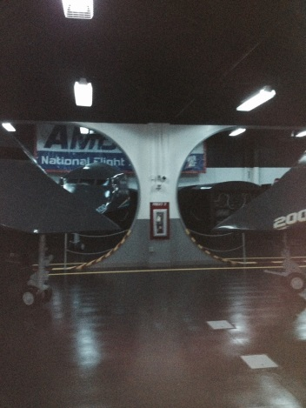
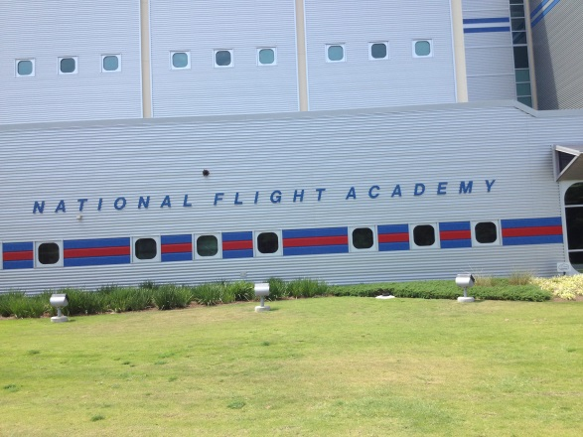

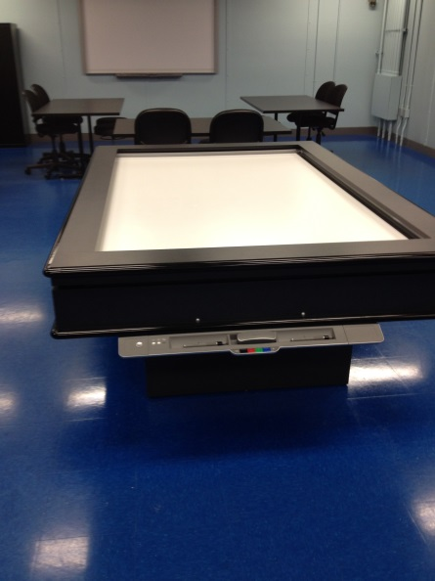

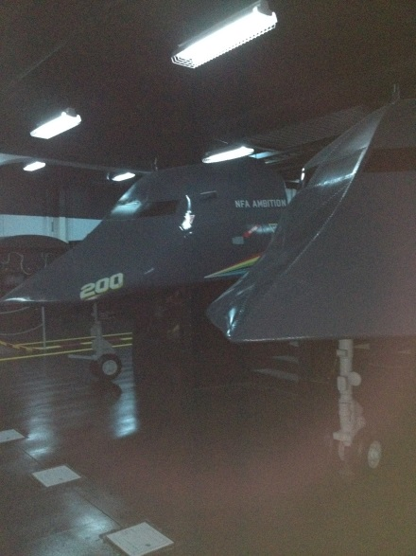
N.A.S. Flight Academy

Slide 9
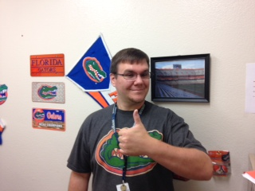
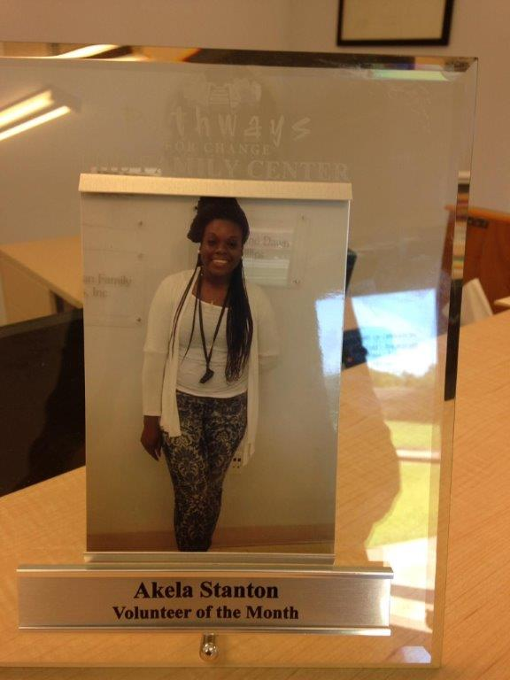
ACT: 18 or >
W.I.A. Youth had two students pass the ACT in June 2014 with an 18 or higher in Reading.
This enabled the students to receive their high school diplomas.
Akela Stanton
Jakeisha McCrery
Fabulous ACT Tutor
Mr. Wolfe

Slide 10
WIA Youth Activities
Florida Ready to Work
During June 2014 10 WFHS Academy students attended training taught by Ms. Angela Irby who is a Business Education instructor at PFHS & Leah McMillan, WIA Youth Case Manager
&
Lubrication Certification (Oil Change) Class
Students received 8 hours of instruction in Automotive Lubrication & Inspection, Tool Identification and Safety Techniques in both February & July 2014

Slide 11
Number of Youth Served
Streamlining the Caseload……
In March 2013 the WIA Youth Program had
198 Active Participants
In August 2014 the WIA Youth Program has
73 Active Participants

Slide 12
Budget Cuts ☹
Despite $61,000.00 in budget cuts W.I.A. Youth was able to continue to serve the same number of students!

Slide 13
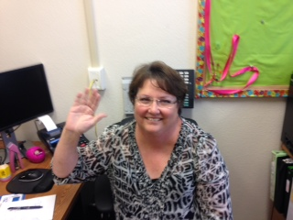
W.I.A. Youth Program
Our New W.I.A. Youth Secretary!
Mary Moorer

Slide 14

CATE ☺

