Slide 1
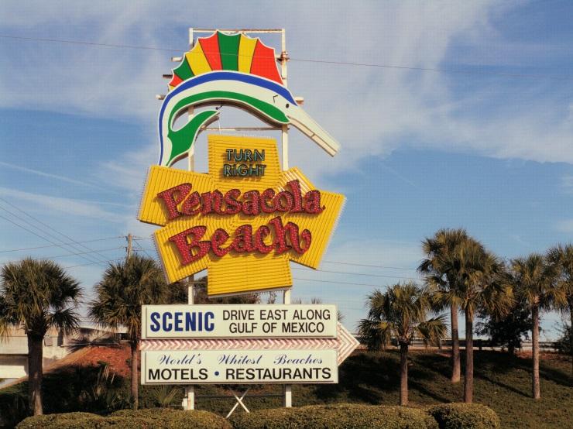
Workforce Services July 1, 2013 – June 30, 2014
Designed by Morgan Cole
Photography by Belinda Todd

Slide 2
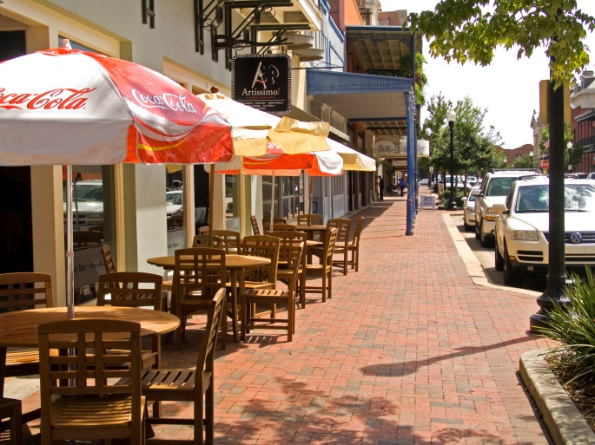
One-Stop Career Center Visitors
Century One-Stop…………7,460
Milton One-Stop………….14,615
Pensacola One-Stop…….81,223
Annual Total = 103,298
3% increase over previous year
FY 2012-2013 Total = 99,969

Slide 3
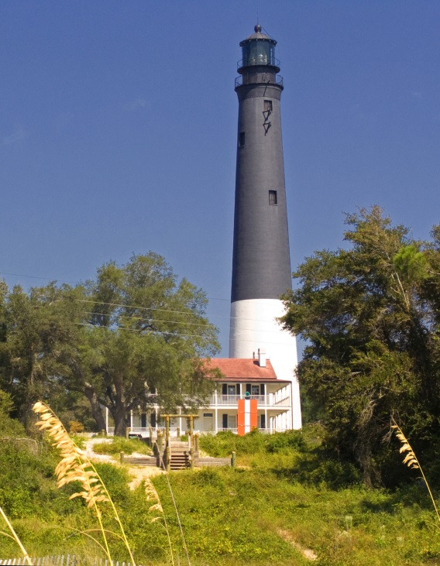
Customers Served
Breakdown of One-Stop Center Visits:
Resource Room Usage = 67,008
Pensacola One-Stop: 47,902
Milton One-Stop: 11,646
Century One-Stop: 7,460
Welfare Transition Program = 18,708
Re-Employment Assistance Claimants = 11,962
Florida EFM Users:
New EFM Registrants = 8,262
More than 440,000 job seeker Services recorded
(Job referrals, workshops, orientations, use of Resource Rooms, etc.)
*Source: DEO Monthly Management Report

Slide 4
RWB1 Demographics
Total Registered Participants = 37,026
Gender:
52% - Female
48% - Male
Age:
1% - Youth < 18
63% - Age 18 - 44
20% - Age 45- 54
16% - Age 55 and up
Disabled:
5% of program participants
Race/Ethnicity:
6% - Hispanic or Latino
2% - American Indian/Alaskan Native
2% - Asian
33% - Black/African American
1% - Hawaiian/Pacific Islander
58% - White/Caucasian
Education Level:
9% - Less than high school
42% - High School Graduate or Equivalent
19% - Some College or Technical Education
4% - Vocational Diploma/Certification
9% - Associate’s Degree
10% - Bachelor’s Degree
3% - Beyond Bachelor’s Degree
Employment Status:
26% - Employed/Working
74% - Unemployed/Not Working

Slide 5
Wagner Peyser
Employ Florida Marketplace Users = 33,800
8,262 New EFM registrants in 13-14 program year
6,073 Wagner-Peyser Registrants entered employment
Average wage for program participants = $11.79/hour
Wagner-Peyser Front-Line Staff Provide: (Average of 200 customers per day)
Customer Support
EFM registration assistance
EFM password re-sets
Scan card distribution
Email inquiries
Re-Employment Compensation Activities
PREP (Priority Re-Employment Planning) Orientations and Assessments
Career/Job Search Counseling
*Source: DEO Monthly Management Report

Slide 6
Workforce Investment Act (WIA)
Workforce Investment Act (WIA)
The Workforce Investment Act of 1998 rewrote federal statutes governing programs of job training, adult education and literacy and vocational rehabilitation.
During the FY 2013-2014:
811 WIA participants were served
592 WIA participants were enrolled in specific training programs
WIA entered employment rate of 91.3% (+ 3% over previous year)*
Average Wages At Placement:
WIA Adult Program:
$14.98/hour (+ 8.5% over previous year)
WIA Dislocated Worker: $15.77/hour (+ 10.5% over previous year)
*Source: DEO Monthly Management Report

Slide 7
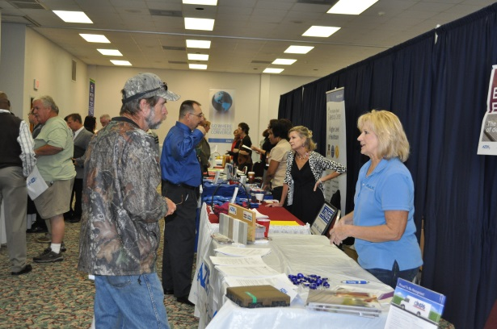
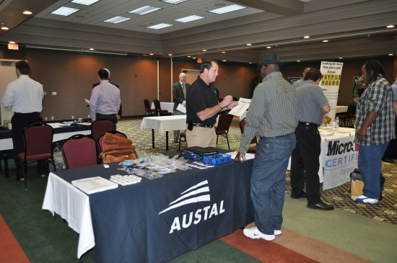
Veteran Services
Veteran Services
What We Do:
Intensive Services
assessment, counseling and job placement services for veterans with disabilities and other significant barriers to employment.
Outreach
Job Fairs and Recruiting Events
Workshops and Seminars for Veterans:
How to Apply for Federal Jobs
Seminars for incarcerated veterans at area correction institutions
Workshops for homeless veterans conducted at area shelters

Slide 8
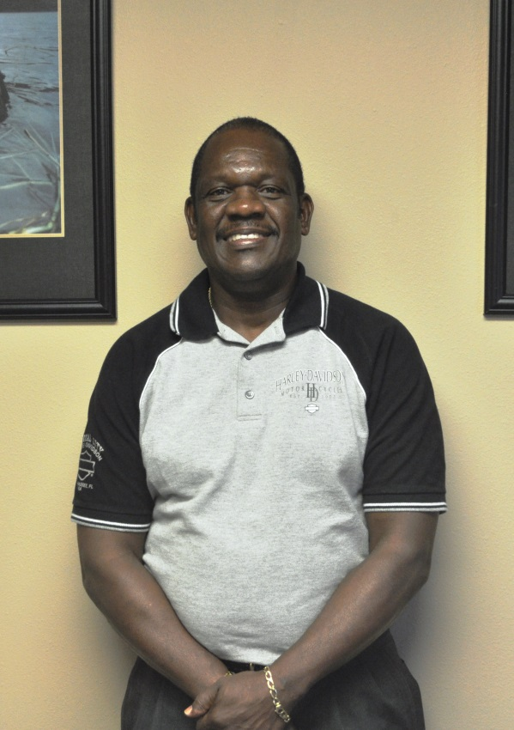
Veteran Services
Veteran Services
Why We Do It:
Success Story
Disabled Veterans Outreach Program Case Manager, Rachel Cain, worked with Gabrieli “Andre” Davis, a 61 year-old Army Veteran who was pursuing an Associate’s Degree in Paralegal Studies through the Veterans Retraining Assistance Program (VRAP), a veteran education benefit program that ended before his training was completed. Mr. Davis, through counseling, was determined to complete his degree and decided to use a Federal PELL Grant to fund the remainder of his education.
Mr. Davis is an ex-offender; it became apparent that even though he interviewed well and had quality credentials on his previous referrals from DVOP Representative Rachel Cain, he needed extra networking assistance to overcome this barrier to employment. Along with being an ex-offender, Mr. Davis is an older veteran which has distanced him from physically rigorous jobs, such as his prior work in the construction industry. Mr. Davis, also qualified as a low income status participant and was referred to the National Caucus & Center on Black Aged Inc. (NCBA) Senior Employment Program. He was placed as a customer service representative at CareerSource Escarosa through this program which provides part-time employment for up to four years. In this position, Mr. Davis has the flexibility to work around his school schedule. It also provides him with the supplemental income he needs to complete his degree and seek employment in his new field. Through the assistance of DVOP Representative Rachel Cain and the NCBA, Mr. Davis is able to provide for himself and his family, while training for his new career as a paralegal professional.
Gabrieli “Andre” Davis
Army Veteran
Paralegal Studies Major

Slide 9
Military Family Employment
Advocacy Program
Program Year-End Results:
312 MFEAP participants were registered and identified in EFM
142 MFEAP participants sought and received services
659 services were provided to MFEAP participants such as:
Job referrals
Assessments
Job search support/assistance
Resume Preparation
Career counseling
Referral to training programs
CareerSource Escarosa provides services to spouses and dependents of active-duty military personnel, Florida National Guard and military reservist through the Military Family Employment Advocacy Program (MFEAP).

Slide 10
Supplemental Nutrition
Assistance Program (SNAP)
In July 2009, Florida implemented a voluntary program to engage food stamp recipients in activities geared toward gaining employment. Activities include job search assistance, vocational training, educational support and work experience. Escambia County is contracted to provide services.
Escambia and Santa Rosa County Cases:
238 participants scheduled for assessment/intake
153 participants completed assessment/intake*
524 participants were assigned to an activity**
385 participants completed one or more hours of assigned activity**
84 participants were enrolled in an educational component**
10 participants entered employment
*Completed assessment/intake count is a true one time number
**Some numbers resulted in a combination of activities within the same month
(i.e. an individual assigned job search, work experience and education component within the same month)

Slide 11
Business Services
Business Services
Posted 2,689 job orders on EFM for FY 2013-2014, representing 3,451 positions (21% increase from FY 12-13)
Registered 1,259 new employers, and provided services to 3,400 business customers. (6% increase from FY 2011-2012)
Provided more than 23,000 services to 3,435 businesses (job orders, job fairs, applicant testing and screening, etc.)
Developed seven (7) On-the-Job (OJT) contracts with three area businesses: Retina Specialty, Berryhill and International Paper.
Hosted 10 recruiting events with more than 1,200 applicants hired.
Held five (5) Career Fairs with 180 employer participants and more than 2,400 attendees.
Conducted Rapid Response services for mass-layoffs with five (5) employers
595 employees were affected by these lay-offs

Slide 12
Hiring Events
Business Services
THE CHALLENGE:
The Florida Department of Economic Opportunity (DEO) challenged Florida’s 24 Regional Workforce Boards (RWBs) to increase their employer penetration rate by 100% for 2013-2014 program year (i.e. total number of employers/businesses served).
Regions were also given a goal to increase the number of Level 1 Services (most intensive) provided to employers by 100%.
Incentive $ to be provided to RWBs that met above goals, with additional $ awarded to the regions that came in first or second place in their size category (small, medium or large).

Slide 13
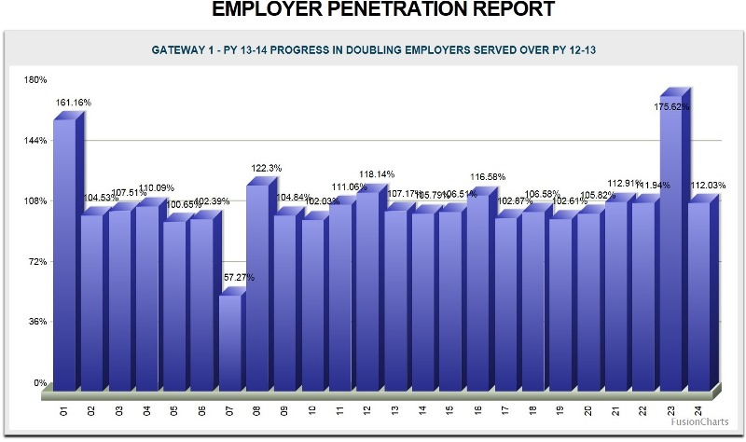
Hiring Events
Employer Penetration
THE OUTCOME:
Increase of 161% over previous year
Ranked 2nd in the state (among 24 regions)

Slide 14
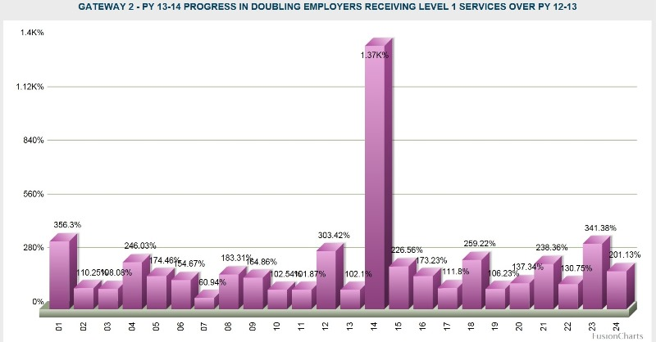
Level 1 Services
Increase of 356% over previous year
Ranked 2nd in the state (among 24 regions)
Escarosa provided Level 1 Services to 90% of their registered employers - more than any other regions

Slide 15
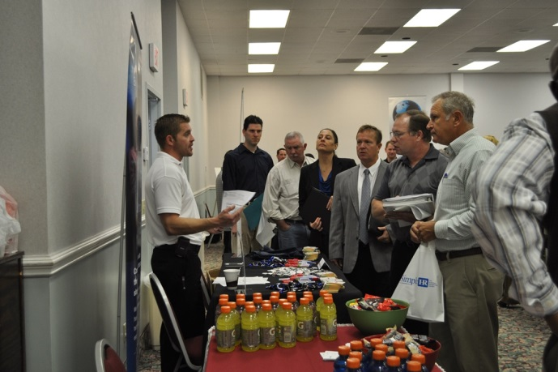
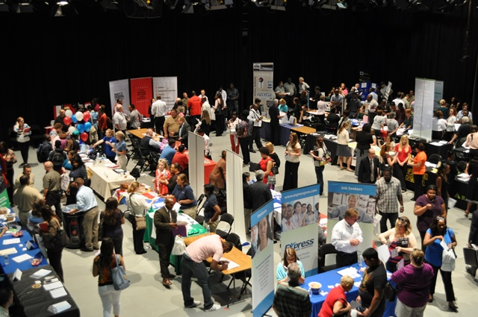
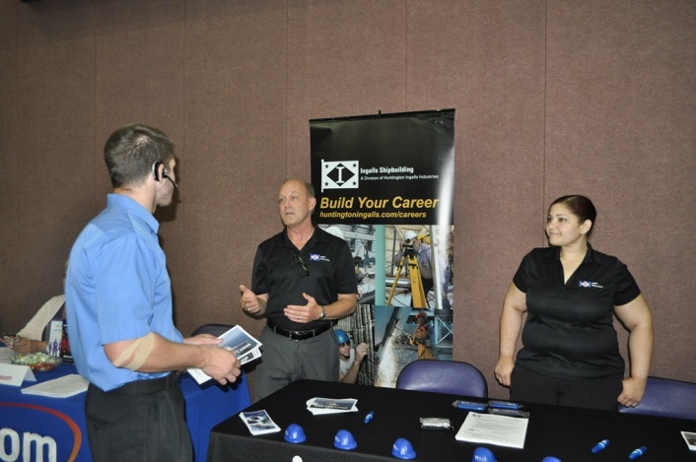
2013-2014 Career Fairs
2012-2013 Career Fairs
South Santa Rosa Career Fair
Friday, October 13, 2013
Location: Pensacola State College Santa Rosa Campus
Attendance: 21 Employers, 132 Job Seekers
5th Annual Fall Community Career Fair
Friday, October 4, 2013
Location: Pensacola State College – Amos Studios (WSRE-TV)
Attendance: 50 Employers, 687 Job Seekers
7th Annual Northwest Florida Veteran’s and Military Hiring Fair
Held jointly with RWB 2
Friday, November 1, 2013
Location: Navarre Conference Center
Attendance: 40 Employers, 251 Job Seekers

Slide 16
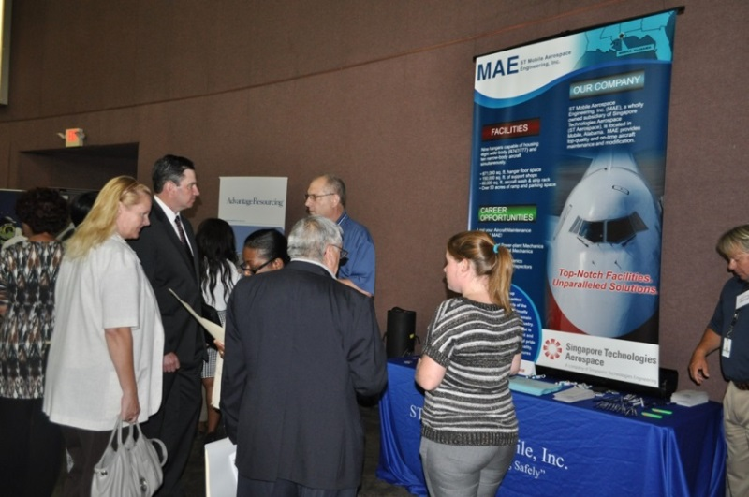
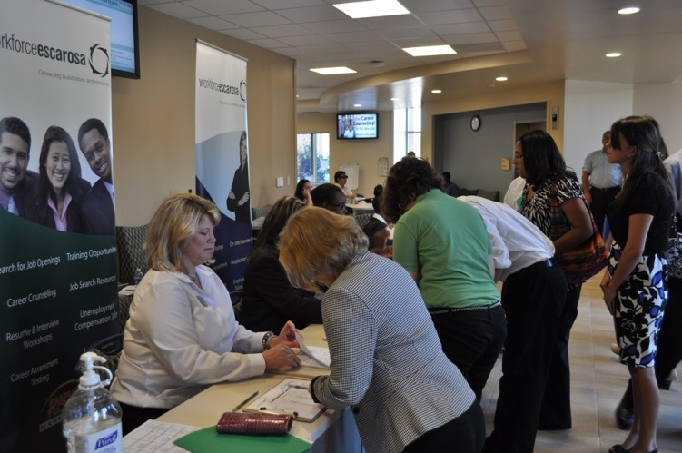
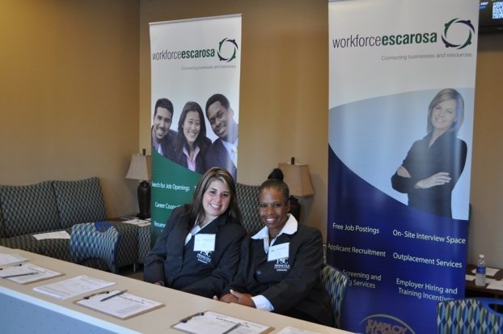
2013-2014 Career Fairs
2012-2013 Career Fairs
Northern Escambia Career Fair
Friday, March 28, 2014
Location: Pensacola State College – Century Center
Attendance: 20 Employers, 90 Job Seekers
Word of Possibilities Job Fair
Held in conjunction with SkillsUSA Career Expo
Friday, April 28, 2014
Location: Pensacola Bay Center
Attendance: 60 Employers, 1,000 Job Seekers
Santa Rosa County Job Fair
Wednesday, June 18, 2014
Location: Pensacola State College – Milton Campus
Attendance: 30 Employers, 224 Job Seekers

Slide 17
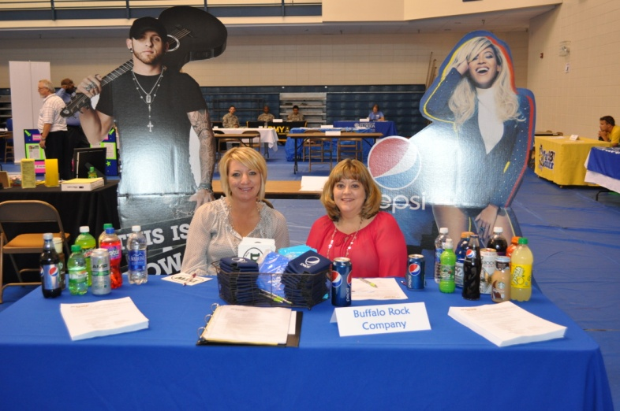
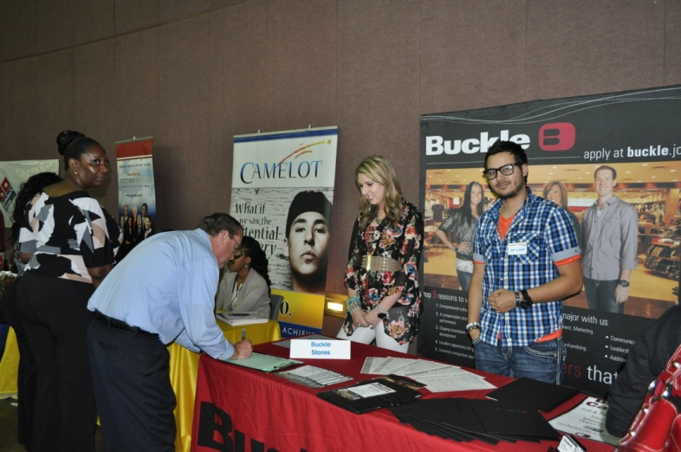
Upcoming Career Fair
2013 Upcoming Career Fairs
6th Annual Fall Community Career Fair
Friday, September 26, 2014
Location: Pensacola State College Main Campus (Amos Studios)
Anticipate more than 60 employers

Slide 18
Workforce Investment Act
Youth Programs
CareerSource Escarosa provides services to youth between the ages of 14-21, who are either at risk of dropping out of school or already out of school, to facilitate the completion of an educational program.
Services Provided:
Career Counseling/Mentoring
Goal Setting
Tutoring
Work Experience
Employability Skills Training
Basic Skills Instruction
Job Shadowing
Leadership Training
Job Development
Job Placement
FY 2013-2014 Service Providers:
School Board of Escambia County
School Board of Santa Rosa County
Children’s Home Society of Northwest Florida

Slide 19
Youth Performance by Contractor
Performance Measure | Children’s Home Society | Escambia County School District | Santa Rosa County School District
Total Participants Served | 177 | 126 | 135
Total In-School Participants | 104/177 59% | 74/126 59% | 89/135 66%
Total Out-of-School Participants (30% required) | 73/177 41% | 52/126 41% | 46/135 34%
Younger Youth Goal Attainment Rate (All youth must attain 1 goal by anniversary date) | 62/64 97% | 75/80 94% | 111/123 90%
Younger Youth Skill Attainment Rate (75% Required) | 62/64 97% | 52/56 93% | 99/113 88%
Younger Youth Credential/Diploma Rate (50% Required) | 30/31 97% | 41/47 87% | 51/58 88%
Younger Youth Positive Outcome Rate as Defined by WIA Exiters entering into post secondary education, advanced training, apprenticeships, military service, unsubsidized employment. (80% Required) | 29/31 94% | 26/32 81% | 34/40 85%
Older Youth Credential/Diploma Rate (40% Required) | 6/6 100% | 4/8 50% | 12/13 92%
Older Youth Positive Outcome Rate as Defined by WIA Exiters entering into post secondary school, advanced training, apprenticeships, military service or employment. (80% Required) | 6/6 100% | 11/12 92% | 7/7 100%

Slide 20
Collective Performance of RWB1 Youth Programs
Total Youth Participants Served = 438
In-School | 267/438 | 61%
Out-of-School | 171/438 | 39% | Must be over 30%
Younger Youth Goal Attainment | 248/269 | 92% | - 2% change from FY 2012-2013
Younger Youth Skill Attainment | 213/233 | 91% | - 2% change from FY 2012-2013
Younger Youth Credential/Diploma | 122/136 | 90% | + 10% change from FY 2012-2013
Younger Youth Positive Outcome | 89/103 | 86% | + 10% change from FY 2012-2013
Older Youth Credential/Diploma | 22/27 | 81% | + 9% change from FY 2012-2013
Older Youth Positive Outcome | 24/25 | 96% | + 14% change from FY 2012-2013

Slide 21
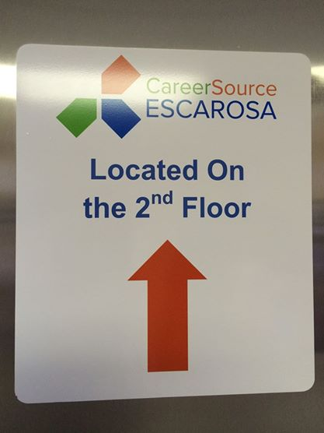
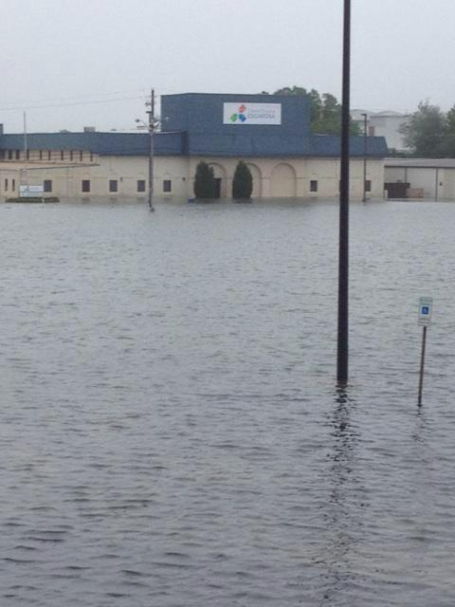
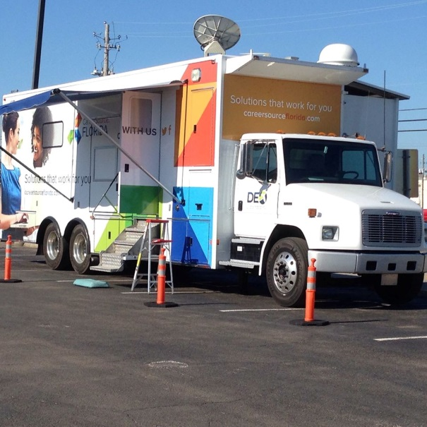
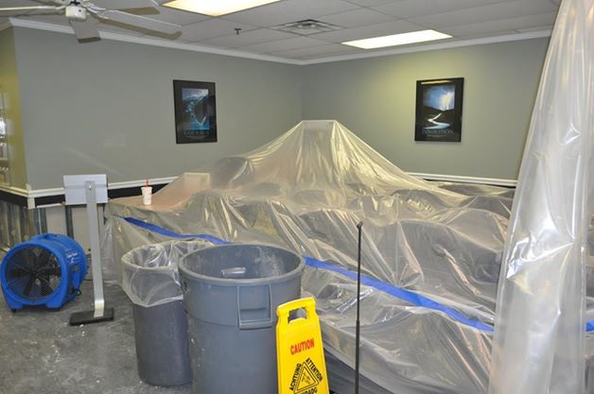
ANOTHER Flood…
Resulted in closings
Set-up operations in parking lot at “L” Street Career Center location
Limited services offered - Mobile one-stop and canopy
Permanently moved all operations to 2nd floor of “L” Street Center
Closings and move resulted in decline is customer visits

Slide 22
Launch of New Brand/Name Change
The Regional Workforce Boards Accountability Act, which took effect July 1, 2012,
directed Workforce Florida to “evaluate the means to establish a single, statewide workforce-system brand for the state.” Following a competitive process, Workforce Florida selected IDEAS of Orlando to lead this branding initiative.
Our New Look:
New Logo
Brand Attributes

Slide 23
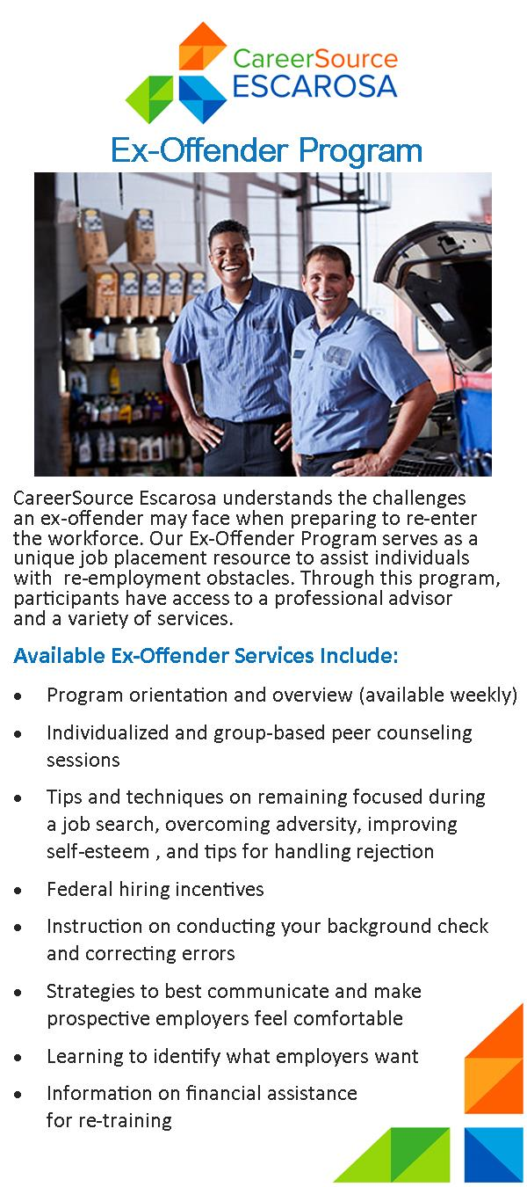
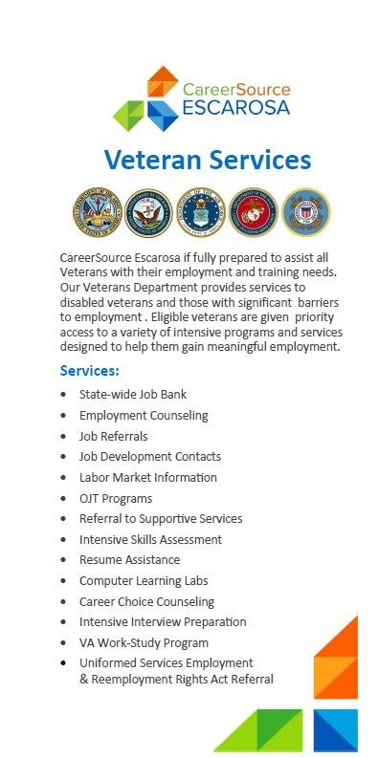
Launch of New Brand/Name Change

Slide 24
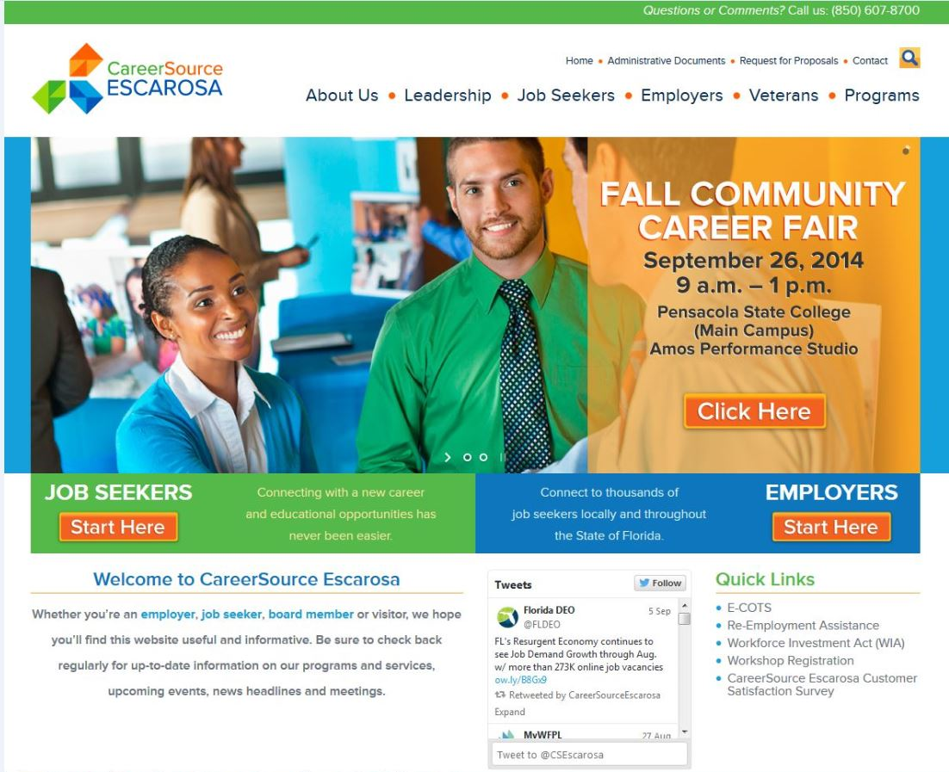
Launch of New Website

Slide 25
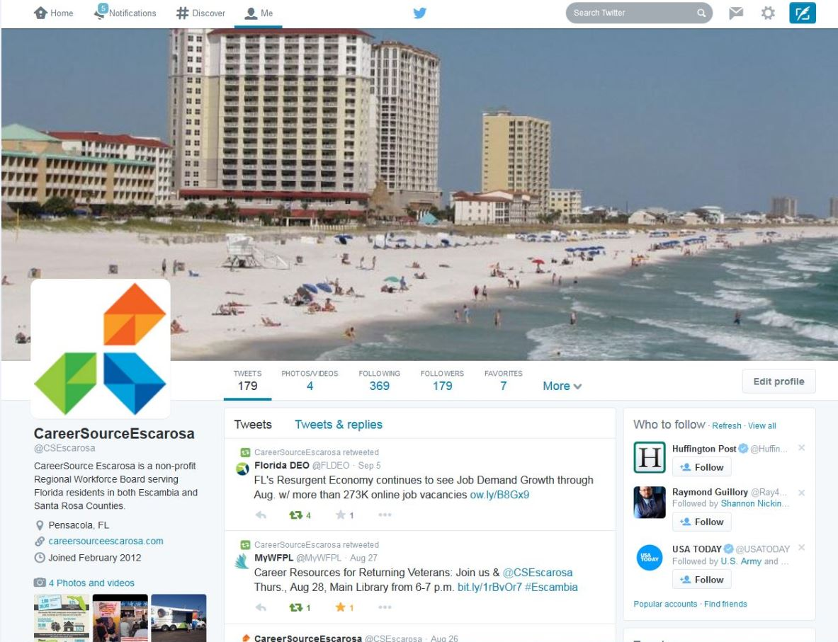
New Social Media
facebook.com/CareerSourceEscarosa
Twitter.com/CSEscarosa

Slide 26
Thank You!

